Slide 1
Mortality rate of ICD 9
Analysis project
DAB-304- Healthcare analytics
Last Updated: April 18th, 2022
Presented By
Fenil Patel

Slide 2
Road Map
Background/Motivation
Problem statement
Target audience
Analysis questions
Dataset description
Data cleaning and transformation
Story telling (with data)
Conclusion
Reference

Slide 3

Background/Motivation

Slide 4
Background/Motivation
Every country in this world has experienced the brunt of COVID-19 in some or the other manner. One of the main repercussions is the high toll of deaths. But before this pandemic, there were many causes of death that were subdivided and classified in a cluster. This classification was termed as ICD(International Classification of Diseases) developed by the International Statistical Institute in 1893, as mentioned above followed by codes for different clusters of diseases.
I gained some knowledge about this coding system in my Healthcare Analytics course in the form of my labs and I was intrigued to find more about the criterion/criteria of the division of ICD codes and so on.
Initially, when I was finding the project domain for my project, I started finding datasets of COVID-19 and Mortality rates and I found this page of mortality rate by age, year, gender, sex, and most important cause of death under the ICD-9 group on the WHO website.

Slide 5

Problem Statement

Slide 6
Problem Statement
My project will only look at the ICD-9 codes and their subsequent data. One of my objectives is to gain more knowledge about coding and what the different codes stand for as well as how they are used.
The questions that I asked is based on the common thought process of people who are just introduced to healthcare and according to this I have chosen the datasets.

Slide 7
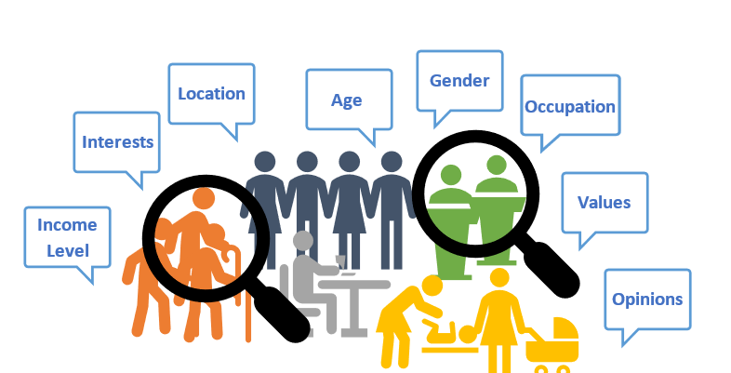
Target audience

Slide 8
Target audience
The Intended audience for this project can include any and all of the following groups:
Any healthcare institute
Any analysis student/s
Any healthcare student/personnel
Someone who is willing to determine insights regarding International Classification of Diseases, Ninth Revision

Slide 9

Analysis questions

Slide 10
Analysis questions
Which country has the highest mortality rate?
What is the most popular cause of death in the ICD-9 group?
In which region or country is this cause of death popular?
Which age group has the cause of death found in question 2 and in which country are they located?

Slide 11

Dataset description

Slide 12
Dataset description
I am going to use two datasets for this project that are interrelated:
In which I have used the data of 5 countries between the years 1991 to 1997.
Morticd9
Pop
USA
Canada
France
Cuba
Australia

Slide 13
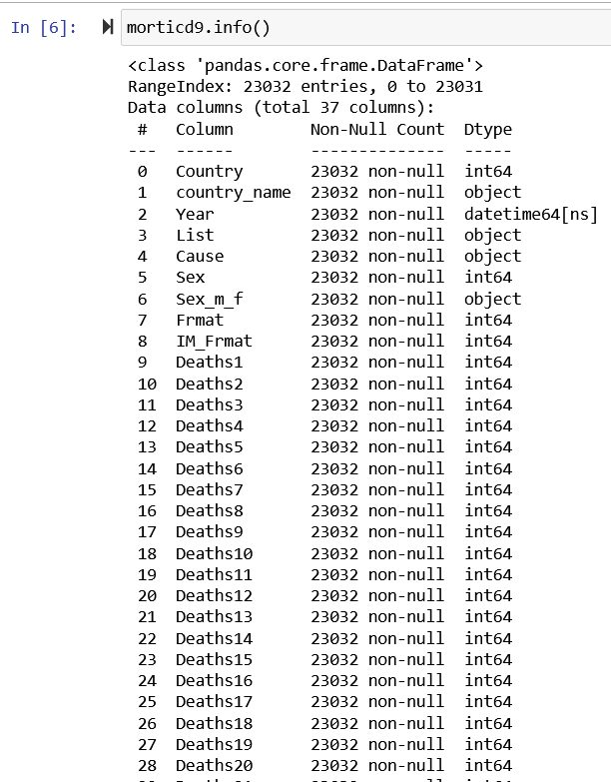

Morticd9

Slide 14
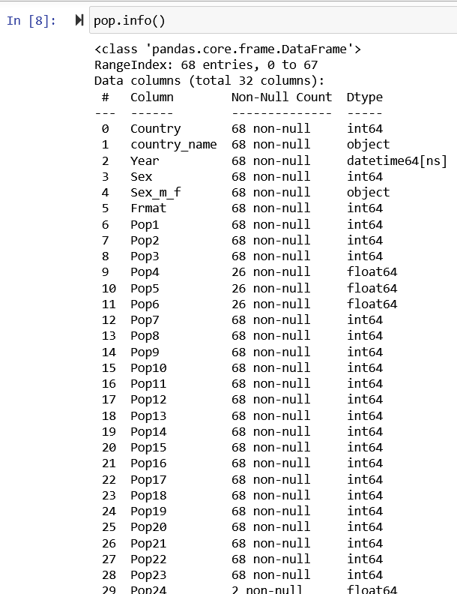

Pop(Population)

Slide 15

Data cleaning and Transformation

Slide 16
Changelog
A changelog is a document used to record the notable changes made to a project over its time across all of its tasks. It is typically word or rmd document, and the changes it records are listed in the form of the versions.
I also have created a changelog to record the cleaning and transformation that I have done in both the datasets.
You can find all the changes that we made here in this Changelog.

Slide 17

Data Analysis

Slide 18
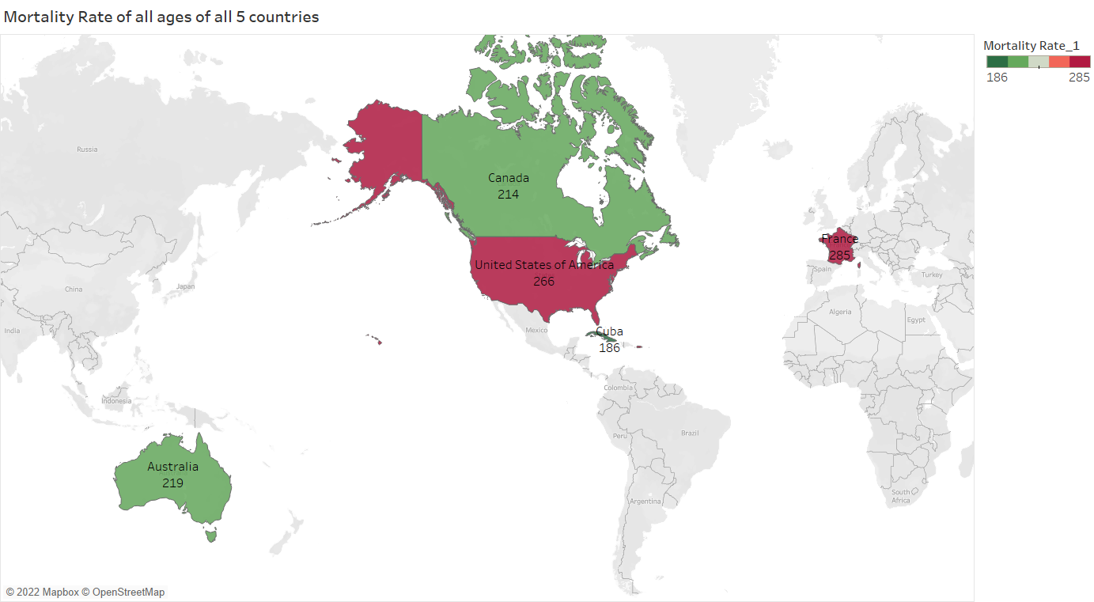
Which country has the highest mortality rate?
France, 285
Mortality rate per 10,000 people in the year of 1992.
France had highest mortality rate.
Cuba had lowest mortality rate.
Cuba, 186

Slide 19
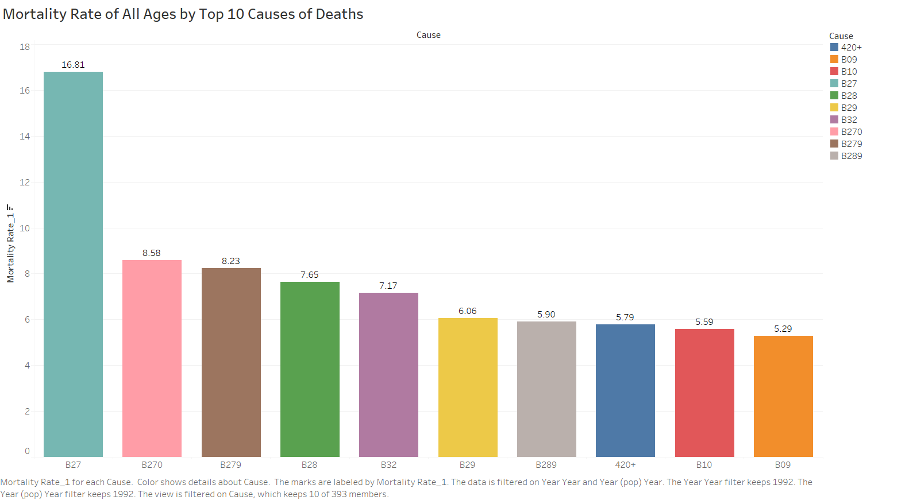
What is the most popular cause of death in the ICD-9 group?
B27 - Ischaemic heart disease had the highest mortality rate of 16.94 ~ 17 people per 10,000 in 1993.
“Heart problems caused by narrowed heart arteries”
B27 was one of the most consistent causes of death from 1991 to 1997

Slide 20
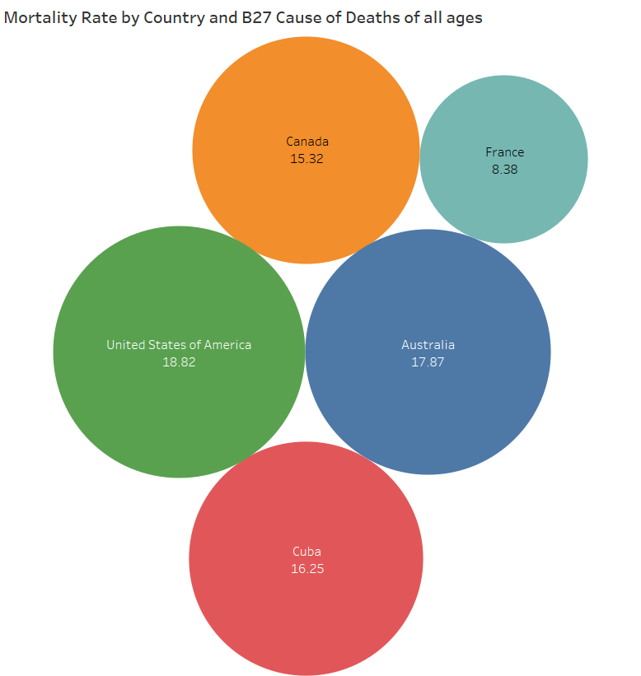
In which region or country this cause of death is popular?
B27 was the most popular cause of death in USA, nearly 19 people per 10,000 sample.
France had the lowest rate for this cause of death however it still had the highest overall mortality rate.

Slide 21
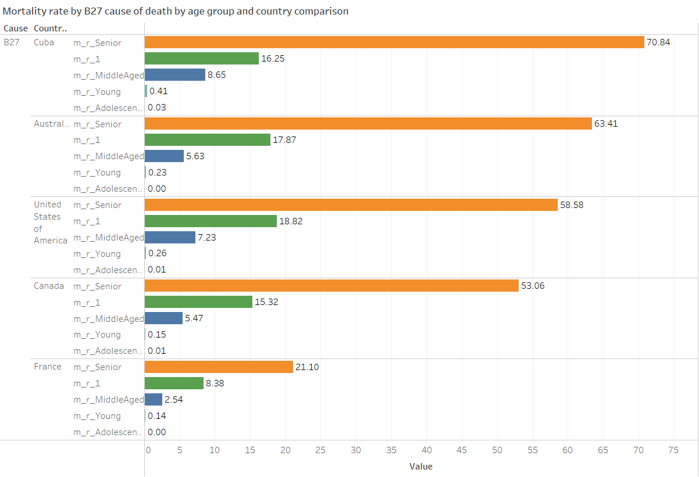
Which age group has the cause of death found in question 2 and in which country are they located?
The Age group of 65-74 and Cuba from all the five countries had the highest mortality rate for the B27 cause of death in the diseases group.

Slide 22
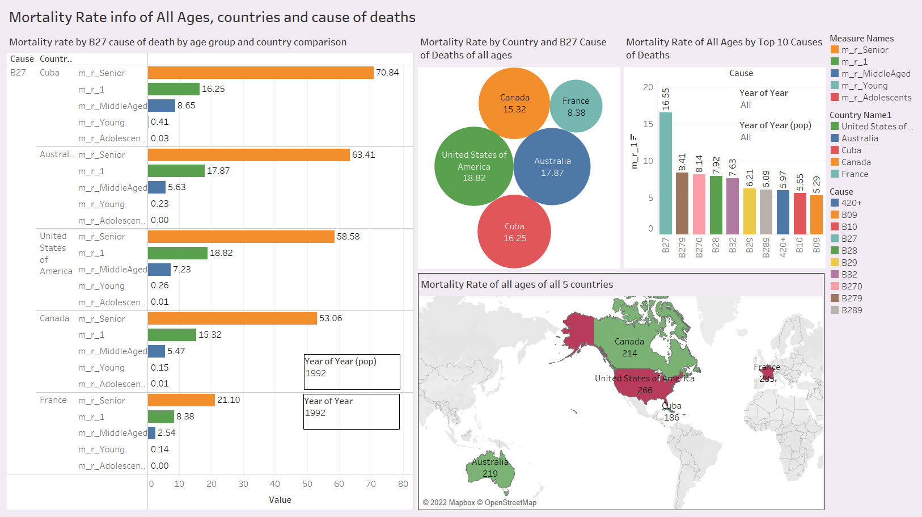

Slide 23
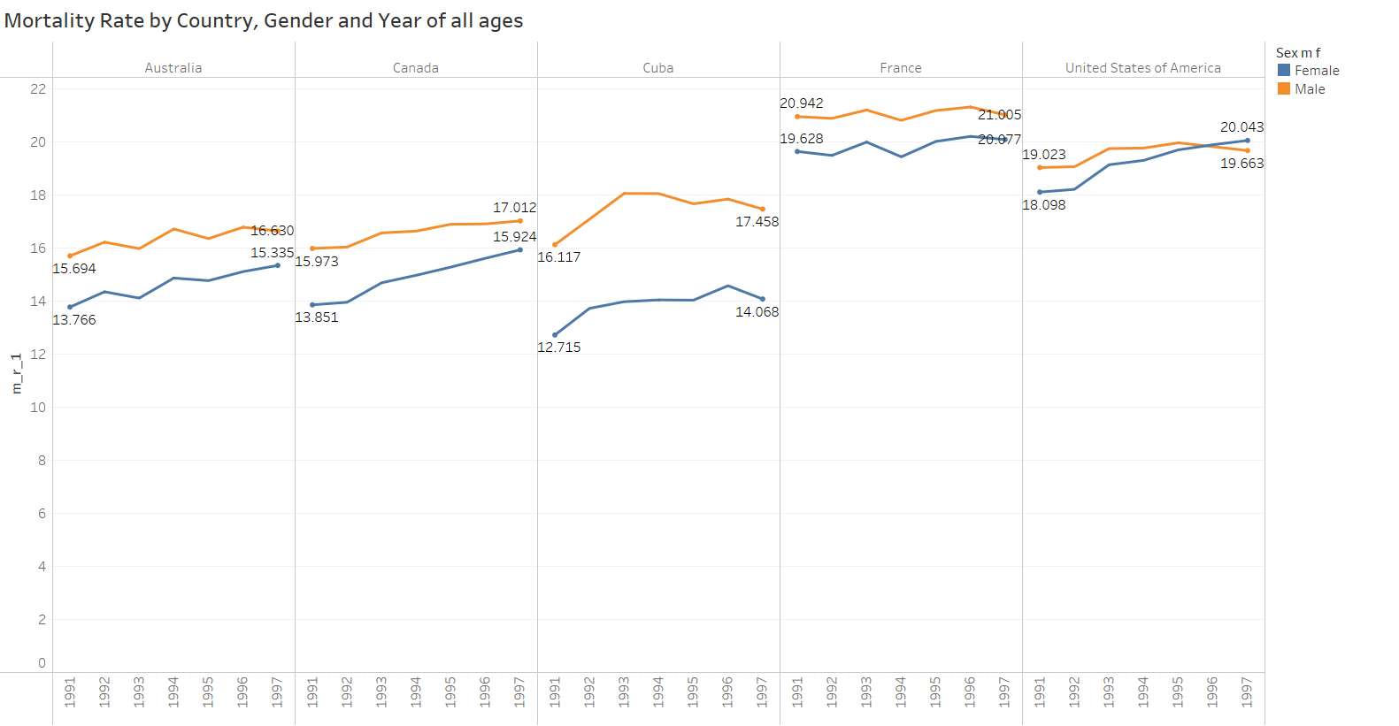
Bonus 1
For every country except USA mortality rate of male was higher than female for the given period of time.

Slide 24
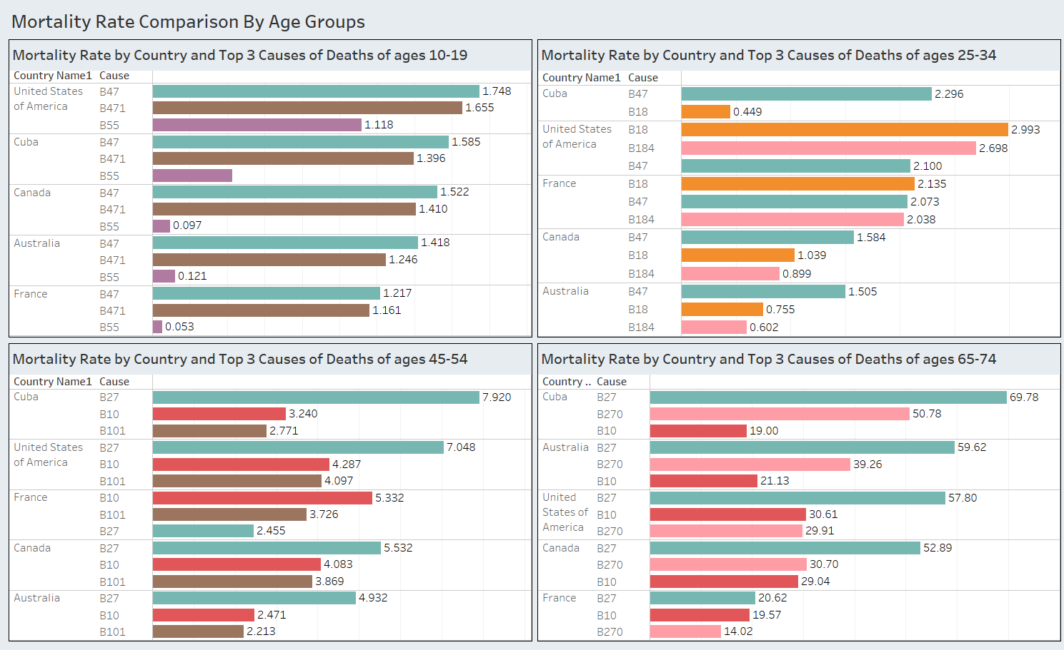
Bonus 2
B47 - Transport accidents
B18 - Endocrine, Nutritional and Metabolic Diseases
B27 - Ischaemic heart disease

Slide 25

Conclusion

Slide 26
Conclusion
After going through all of the graphs above, I can say that France had the highest mortality rate but cause of death being B27 had a lower ratio amongst the other diseases.
On the other hand, Cuba had the lowest mortality rate but most of them died due to Ischaemic heart disease (B27).
And age group that was affected the most due to Ischaemic heart disease (B27) were the senior citizens aged 65 to 74 years old. This means that senior citizens were most likely to die due to heart diseases.
From age 10-34 they had the highest mortality rate by dying in transport accidents(B47).

Slide 27

Reference

Slide 28
Reference
For images in title slides: Google Images
For changelog : Google colab
For grammar correction: Grammarly
Code for merging the two dataset: Softhints
For Presentation: Google Slides

Slide 29


